Slide 1


Predicting Heart Disease
By: Jamie Tran

Slide 2

Background Heart Disease:
Leading cause of death in the United States.
Early intervention can make a world of a difference.
Lifestyle changes and medications.
Notes:
our model will be designed to aid in early intervention to help patients get the help they need

Slide 3

Research Purpose:
Creating a model that can predict the diagnosis of heart disease.
Improve public health.
Aid those in the medical field better serve their patients.

Slide 4

Data elements:
Collected from Kaggle.com.
270 individuals and 14 characteristics of them.
This data set contains individuals with and without heart disease.

Slide 5
Data Preparation:
No missing values.
Convert Heart Disease Prescence column to integers.
Remove Patient column.
Split into x and y data frame
Split training and test set.

Slide 6
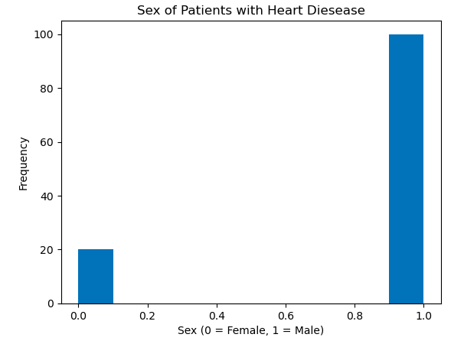
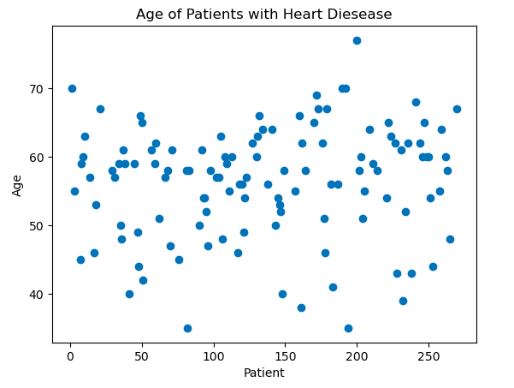
Method:
-Exploratory Data Analysis to get familiarize myself and explore trends that may be present.
-Logistic Regression.
-Trying to predict categorical information.

Slide 7
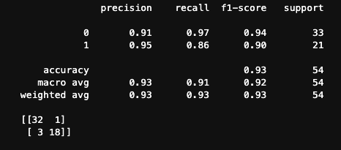
Results:
Key metrics include:
Precision
F1-score
Accuracy

Slide 8

Conclusion:
Great model to build off
Should be tested with larger datasets and different pools of patients
Eventually I would like this model to operate on a spectrum

Slide 9
References:
Kapoor, Prakhar. “Cardio Health Risk Assessment Dataset.” Kaggle, 30 May 2024, www.kaggle.com/datasets/kapoorprakhar/cardio-health-risk-assessment-dataset.
“Heart Disease Deaths - Health, United States.” Centers for Disease Control and Prevention, Centers for Disease Control and Prevention, 26 June 2023, www.cdc.gov/nchs/hus/topics/heart-disease-deaths.htm#:~:text=Heart%20disease%20has%20been%20the,States%20since%201950%20(1).
“Preventing Heart Disease.” Centers for Disease Control and Prevention, Centers for Disease Control and Prevention, www.cdc.gov/heart-disease/prevention/index.html#:~:text=By%20living%20a%20healthy%20lifestyle,heart%20disease%20and%20heart%20attack. Accessed 22 June 2024.
professional, Cleveland Clinic medical. “The Many Types of Heart Disease.” Cleveland Clinic, my.clevelandclinic.org/health/diseases/24129-heart-disease. Accessed 22 June 2024.

